Slide 1

Real ESTATE PROPERTY MANAGEMENT SYSTEM
Buy, sell and rent property easily

Slide 2
Introduction
ABSTRACT
Real estate property management system is a system which provide functionality to buy shell or rent your property. This system will provide facility to the user to search Residential and Commercial property and view property. This system will provide facility to view the property by admin and user. User will able to upload the property information to the app and able to manage it. You will able to sort property by category, location, rent, price and area.
This system will provide facility to the user to fill up their requirement and according to their Requirement Admin can add the Requirement property. This system will provide facility to the user to publish advertise to the app and view. This system will provide facility to the user to feedback to the application. This system will provides some additional features like furniture, color paint, paste-control, sanitizer, documentation, home cleaning, home designing, home loan, home transportation for movers & packers.

Slide 3

Tools & technology
Front - end:-
HTML
CSS
BOOTSTREP
JAVASCRIPT.
Back - end :-
PHP
MySQL.

Slide 4



existing system
disadvantages of existing system
Advantages of our system
1. time consuming.
2. not free they paid some charges for rent or sell property.
3. property comparing mechanism is not available.
4. hard to find exact location by area.
5. pay money for broker.
1. trusted for local residential.
2. easy to use for all users.
3. finding by location, rent, area is very easy.
4. property comparing is available.
5. user friendly & quick response.
6. all property and all users are verified so its secure.

Slide 5
PROCESS MODEL
Incremental model :-
The incremental model combines element of the liner sequential model with the iterative philosophy of prototyping. Each liner sequence produces a deliverable “increment” of the software.
In increment model first increment is called core product. In core product basic requirements are added but some unknown supplemental features remains undelivered. This core product is used by customer to evaluates the system and next increment is planned to develop.
During first requirement analysis phase, customer and developers specifies as many requirements as possible and prepare documentation. Now first version of product with minimal and essential eateries launched to market. Based on the feedback and experience with this version, list of additional features are added. The process is repeated following the delivery of each increment, until the complete product is produced.

Slide 6
Why use incremental model ?
Its contains less cost and time is required to develop first increment called core product .
Less risk is possible to develop system.
It can result in better testing, because testing each increment is likely to be easier than testing entire system.
The feedback providing at each increment is useful for determining the final requirement of system.

Slide 7
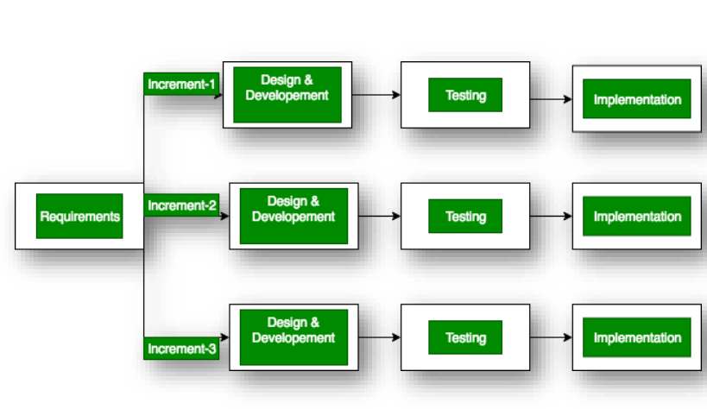
Incremental model

Slide 8
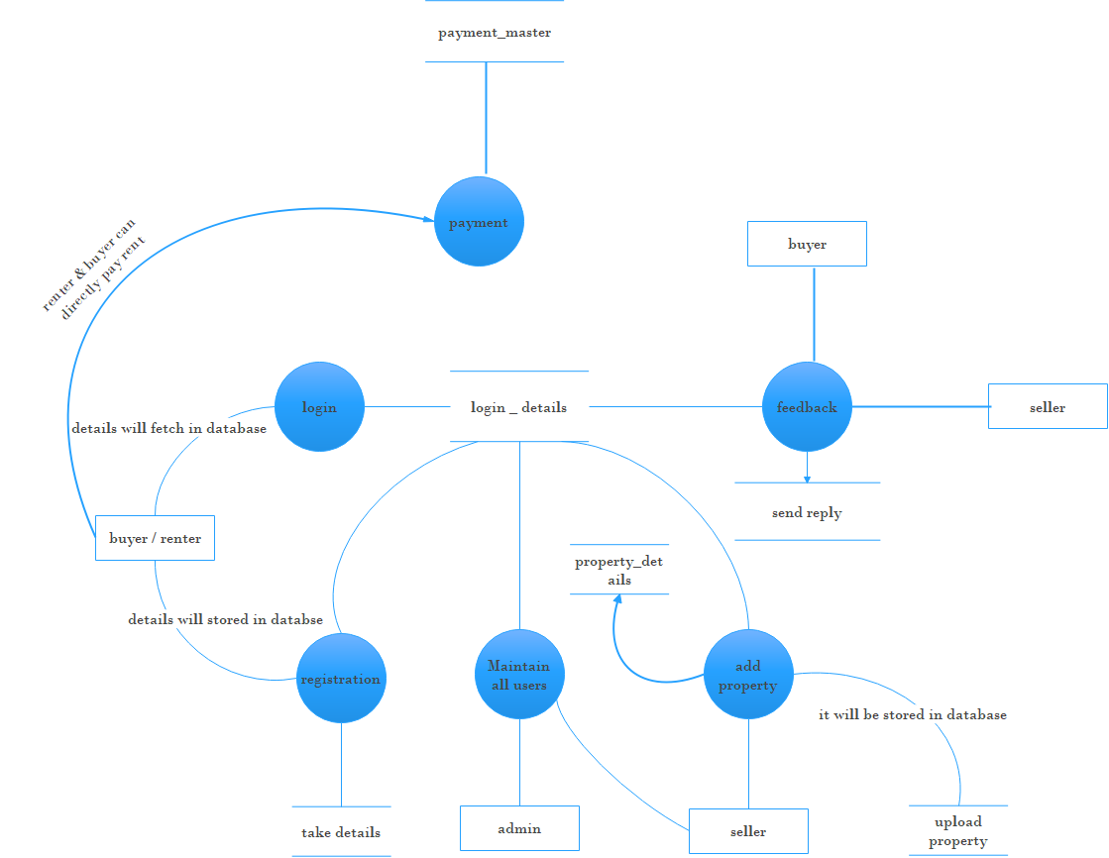
DFD DIAGRAM

Slide 9
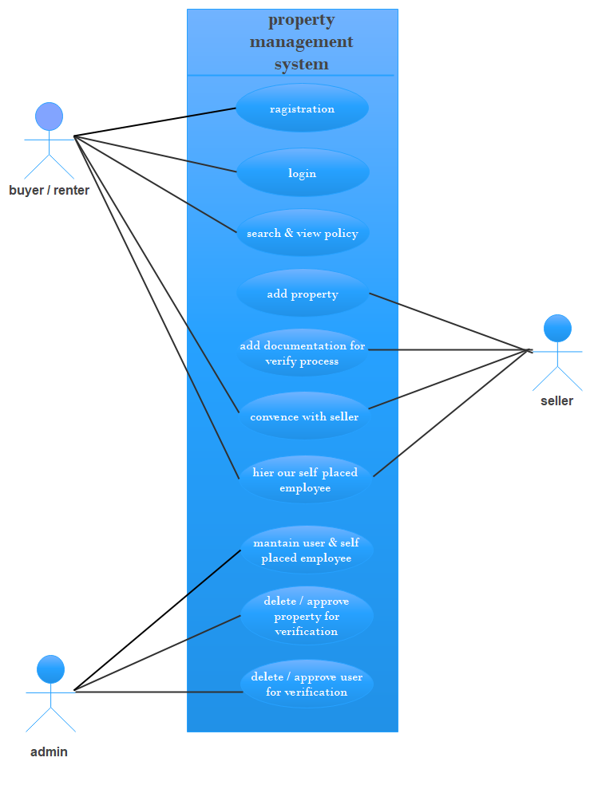
USE-CASE DIAGRAM

Slide 10
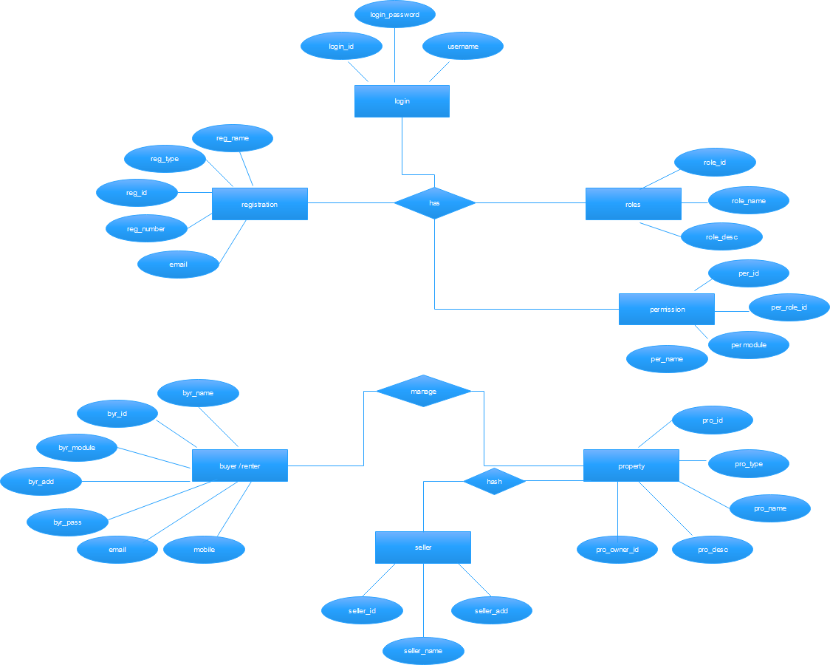
E-R DIAGRAM

Slide 11
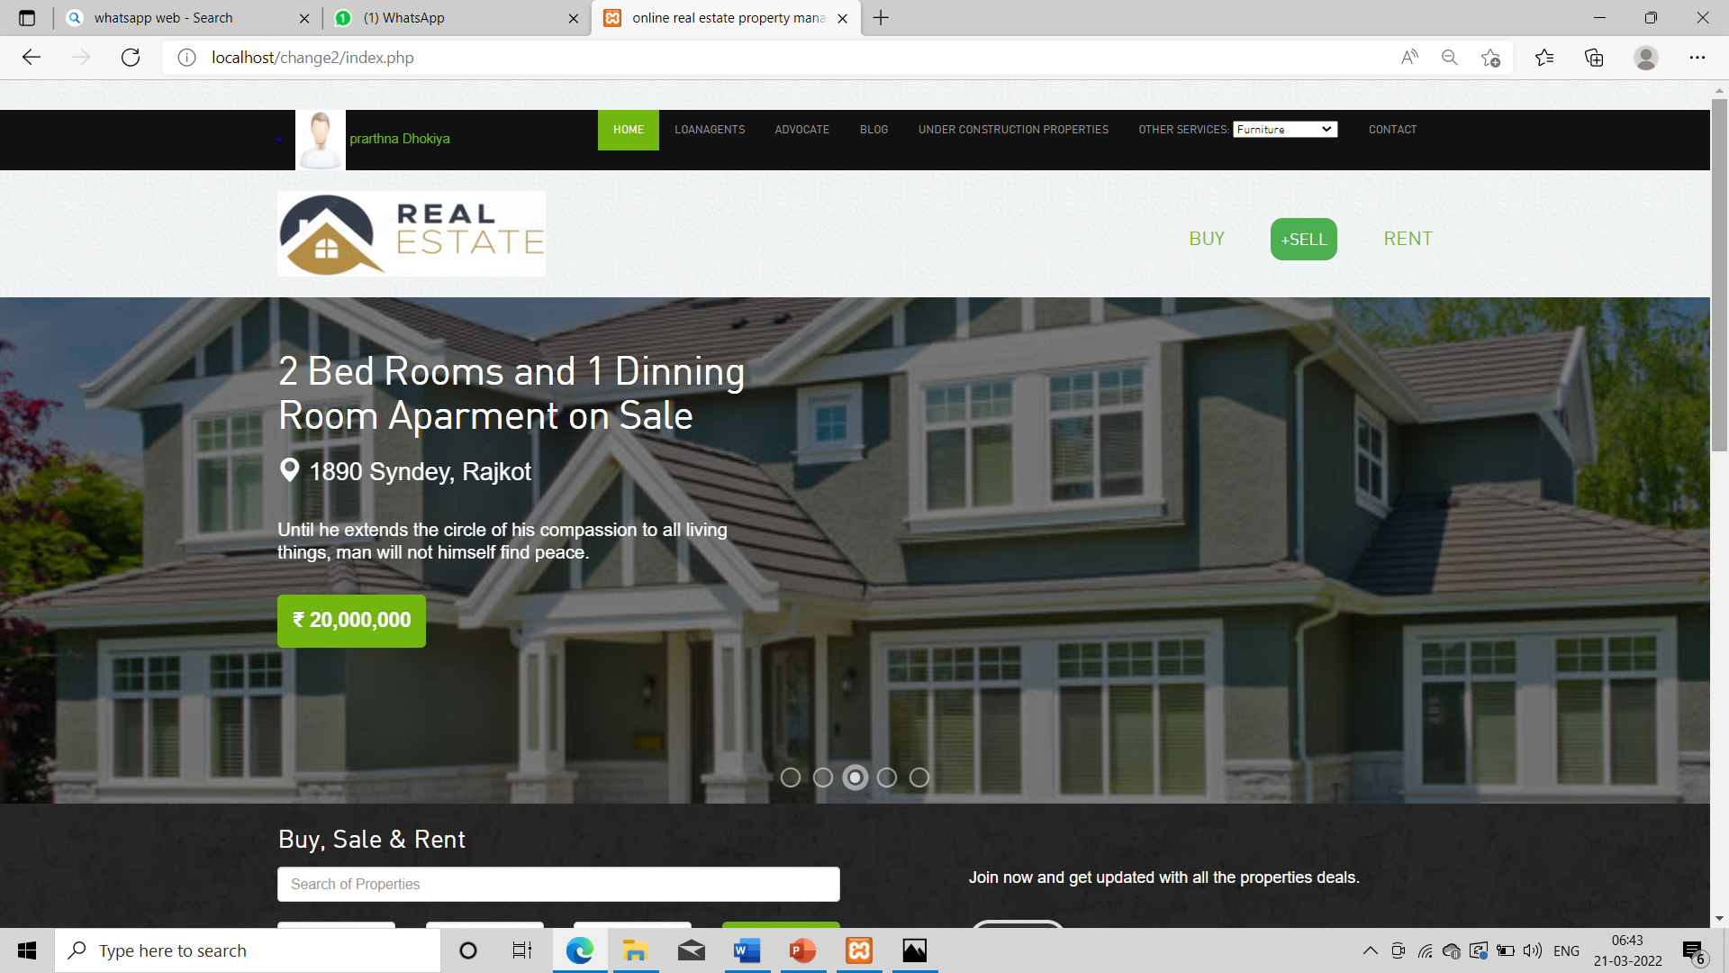
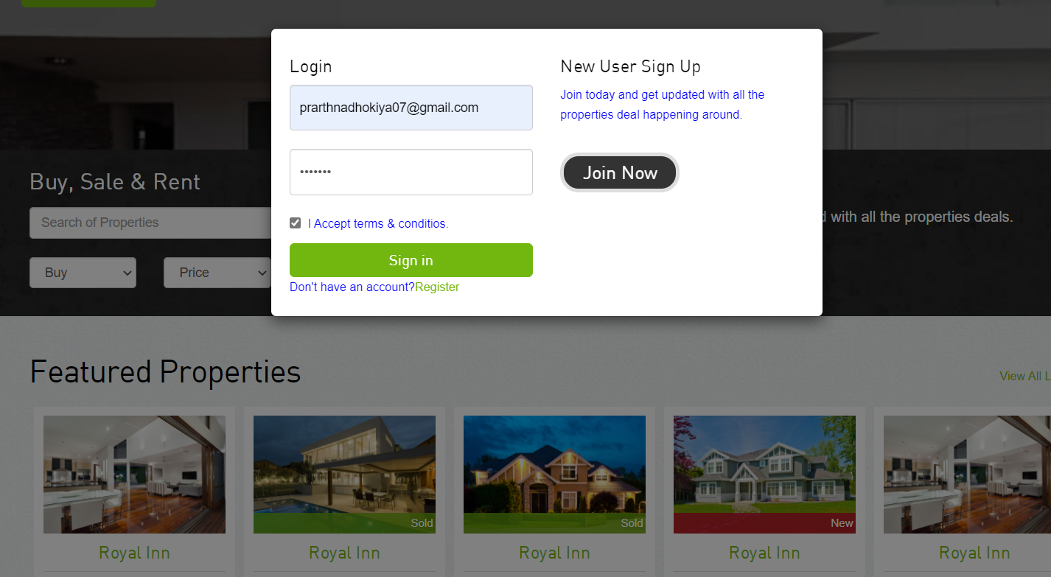
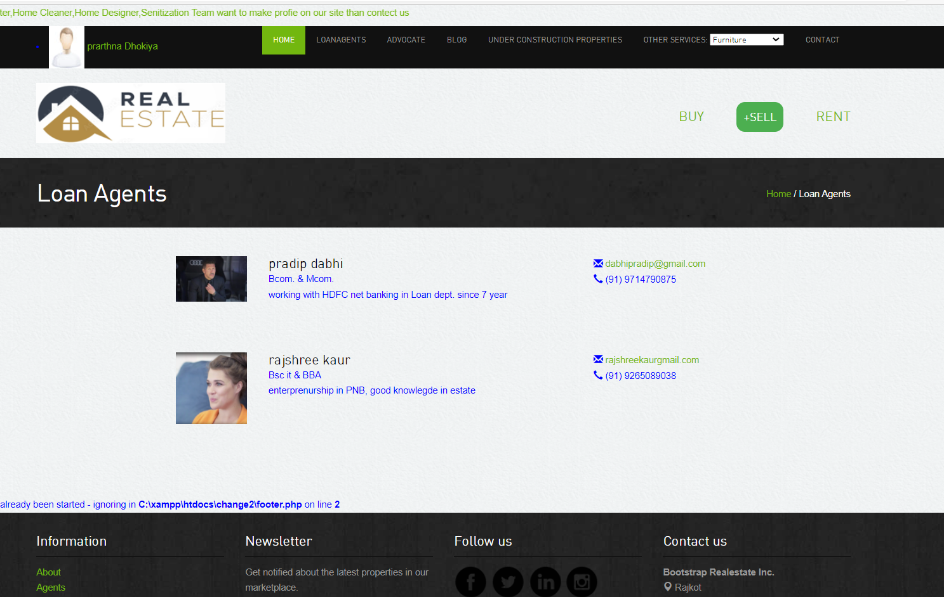
Graphical User Interface Design

Slide 12
Conclusion
We want that our system is gives every information to user which is related to property deal.
We want that self employed businesses can get customer with the help of Real Estate.

Slide 13
Future Scope
OTP sending mechanism for verify user.
Live chat for seller and buyer.
Comparison of property.
Verification process for User who want verified profile with the help of Government Id.

Slide 14
TEAM
Project By :
Kinjal Bharadva (196020307009)
Prarthna Dhokiya (196020307026)
Hetal Gohel (196020307039)
Guided BY:
Miss. Krupa Thumar

Slide 15
Thank you
pkh7@googlegroups.com

